Slide 1
A BRIEF SURVEY OF THE
NEW TESTAMENT

Slide 2
PART 2
THE FOUR GOSPELS

Slide 3
Notes:
Please take out your notes.

Slide 4
Taylornotes.info/prime
Notes:
My website
Notes
Schedule

Slide 5
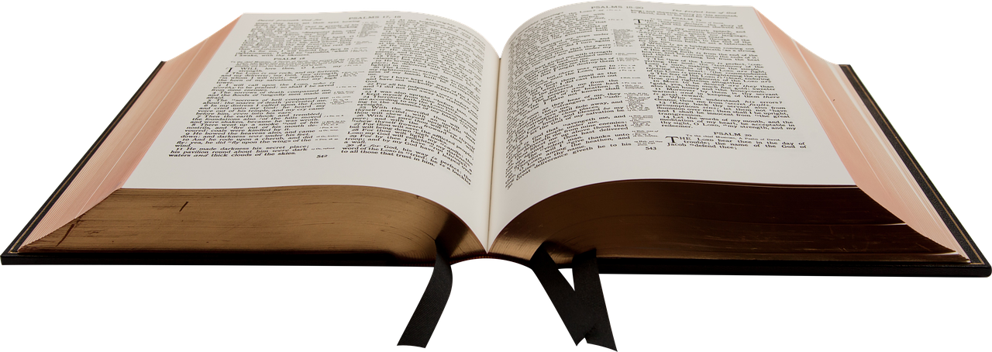
NEW TESTAMENT SURVEY
The Four Gospels
Notes:
Why 4?
Why at beginning of NT?
Why called “Gospels”?

Slide 6
Please mute your mic until you are ready to speak. Thanks
to speak, press and hold the space bar.
Notes:
Thanks for muting yourself…to speak, press and hold the space bar

Slide 7
Please sign in each week
CHAT BOX
George Thompson
Betty White
Warren Willsby
Ed Asner
Sue Thompson
Don Schultz
Please type in your name each week
Notes:
Please type in your name each week (credit toward certificate)
Handouts (me)

Slide 8
Taylornotes.info/abt
Notes:
My website
Notes
Schedule
Zoom Downloads
About the ABT Program

Slide 9
MACRO
Micro
Micro
Micro
Notes:
Macro before micro!
This course
Will give the Big picture (macro) each NT book
Characters
Main idea
How it applies to your life

Slide 10
How would you describe the NEWS you see on TV ?
Notes:
QUESTION
How would you describe the NEWS you see on TV ?
(bad news?)

Slide 11
What kind of “NEWS” does the Bible present?
Notes:
QUESTION
What kind of NEWS does the Bible present?
ANSWER
Good news
Why “ggod”?

Slide 12
THE WORD “GOSPEL” MEANS…
GOSPEL → Greek word euaggelion→ Good News
→ Old English gōdspel, from gōd ‘good’ + spel ‘news, → (“to announce good news”).
Greek pronunciation of euaggelion → “evangelist”
Four Gospel writers are referred to as evangelists.
Notes:
THE WORD “GOSPEL” MEANS GOOD NEWS
Good News is…
As believers in Jesus Christ our sins are forgiven.
We are his children.
We have eternal life.
GOSPEL → Greek word euaggelion → Old English gōdspel, from gōd ‘good’ + spel ‘news, → (“to announce good news”).
Greek pronunciation of euaggelion → “evangelist”
Four Gospel writers are referred to as evangelists.
An evangelist spreads good news.

Slide 13
The good news is that the gospel satisfies our greatest needs!!
Notes:
The GOOD NEWS is that the gospel satisfies our greatest needs!

Slide 14
The NEED
The GOOD NEWS
JEWS
looking for the Messiah
MATTHEW
JESUS is the Messiah
ROMANS
looking for a leader
MARK
JESUS is the Servant Leader
GREEKS
looking for truth
LUKE
JESUS is the Truth
ALL PEOPLE
looking for the immortality
JOHN
JESUS is the Giver of eternal life
Notes:
The Gospels are four of the most powerful books in the whole Bible
The GOOD NEWS of the Gospels satisfies every person’s needs!!

Slide 15
Comparison of the Gospels
 | Matthew | Mark | Luke | John
Jesus as… | King (Messiah) | Servant | Son of Man | Son of God
Emphasis | His Sermons | His Miracles | His Parables | His Doctrines
Culture of recipients | Jews | Romans | Greeks | The World
Style of writer | Teacher | Preacher | Historian | Theologian
Notes:
Why 4 Gospels?
Each presents an aspect of Jesus Christ that gives us a unique description of who Jesus is.

Slide 16
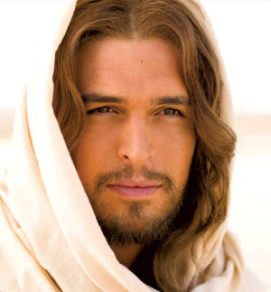
MATTHEW
MARK
LUKE
JOHN
THE GOSPELS COMBINED GIVE A COMPLETE PICTURE OF JESUS

Slide 17
Three of the four Gospels are SYNOPTIC
Notes:
Three of the four are called SYNOPTIC Gospels
Synoptic means “taking the same point of view."
The first three books of the New Testament, which share content, style, and order of events and which differ largely from John, are called the synoptic Gospels.

Slide 18
Matthew, Mark, Luke
(synoptic Gospels)
Life of Jesus
John
Notes:
Three of the four are called SYNOPTIC Gospels
Synoptic → “taking the same point of view, seeing together"
Matt, Mark, Luke →share content, style, and order of events and which differ largely from John
Matt, Mark, Luke → Jesus’ birth to his ascension
John
Other Gospels out for about 40 years
He wanted to provide more details about Jesus’ later days

Slide 19
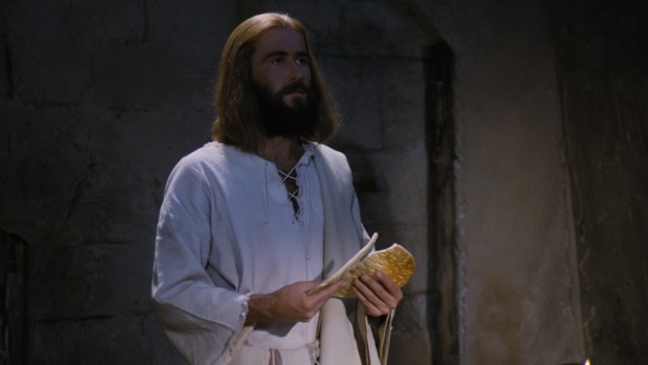
4 BC
AD 20
AD 40
AD 60
AD 80
AD 100
Jesus Christ
Mark
John
Matt.
Luke
Notes:
JOHN
wrote much later than Matt…Mark…Luke
Wanted to emphasize Jesus as the Son of God
His content is distinct from Matt…Mark…Luke
He emphasized Jesus’ teachings…why he died and rose again
A great 1st book to read as a new believer

Slide 20
The Six Major Periods of Christ’s Life

Slide 21
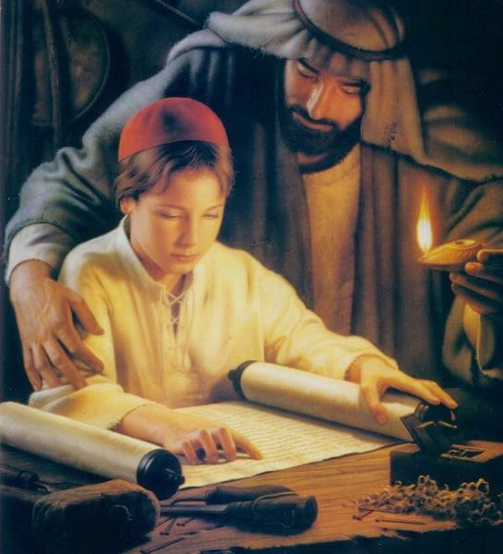
Jesus’ Boyhood
Age: birth (4-6 B.C.) to 12 years old.
Place: Bethlehem (Judea).
Beginning with: His birth (Matt. 1-2; Luke 1:1—2:38).
Ending with: Jesus in the Temple (Luke 2:39-52).
JESUS’ BOYHOOD
Notes:
Period 1: Jesus’ Boyhood
Age: birth (4-6 B.C.) to 12 years old.
Place: Bethlehem (Judea).
Beginning with: His birth (Matt. 1-2; Luke 1:1—2:38).
Ending with: Jesus in the Temple (Luke 2:39-52).
Significant events
Jesus’ dedication (Luke 2:22ff);
flight to Egypt (Matt. 2:13-23).
Jesus spoke Aramaic, the common language of Galilee during his lifetime.

Slide 22
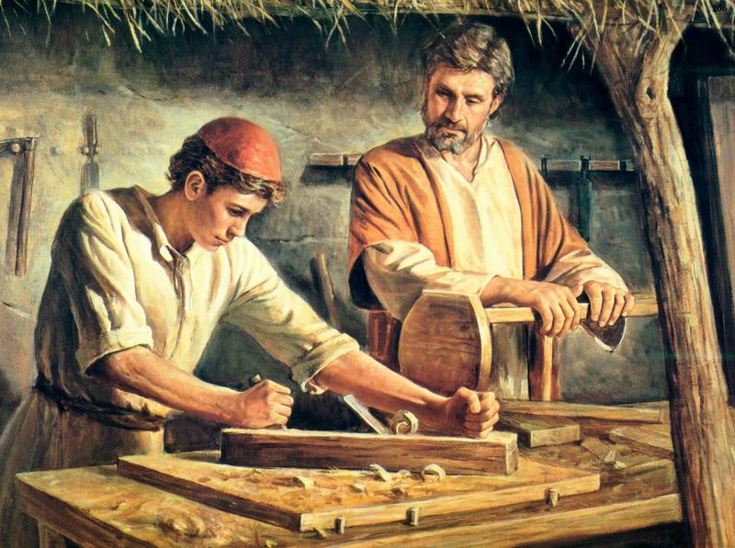
JESUS’ HIDDEN YEARS
Age: 12 to late 20s.
Place: Nazareth (Galilee).
He probably cared for his family since Joseph may have died in Jesus’ younger days.
Notes:
Period 2: Jesus’ Hidden Years
Age: 12 to late 20s.
Place: Nazareth (Galilee).
He probably cared for his family since Joseph may have died in Jesus’ younger days.
Family: his father was Joseph (not born of), his mother was Mary, and he had four half-brothers: Simon, Judas (Jude), Joseph (Jr.), James, and at least two half-sisters (Mark 6:3).
The public teaching of Jesus shows that he was a close observer of the sights and sounds of nature, and of the habits of all classes of men, for these are the usual sources of his illustrations.

Slide 23
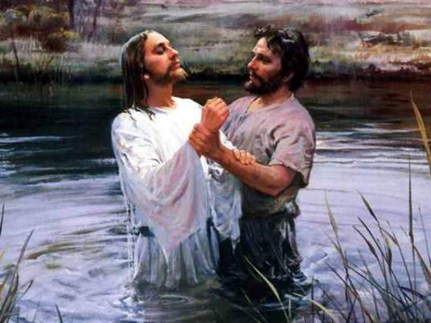
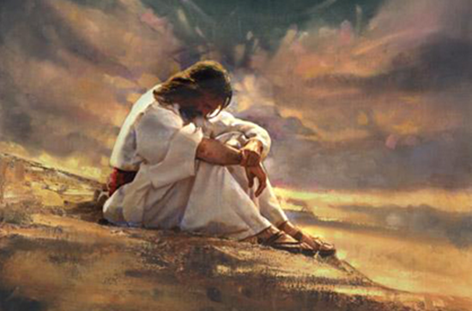
JESUS’ TEMPTATION
JESUS’ BAPTISM
Notes:
Period 3: Jesus’ Baptism and Temptation
Age: Late 20s to early 30s.
Place: Jordon River, wilderness.
Begins with: Jesus’ baptism (Matt. 3:13-17; Mark 1:9-11).
Why was Jesus baptized?
To show support of what John was doing
To show that he was identifying with penitent people vs. Pharisees
It inaugurated his ministry
Ends with: Jesus’ temptation by Satan (Luke 4:1-13).
40 days/nights in desert wilderness (no food)
None of the gospels say anything about Jesus drinking water or sleeping, but they do report that Christ fasted or did not eat anything
Jesus was at his weakest, Satan at his strongest
Jesus defeated Satan

Slide 24
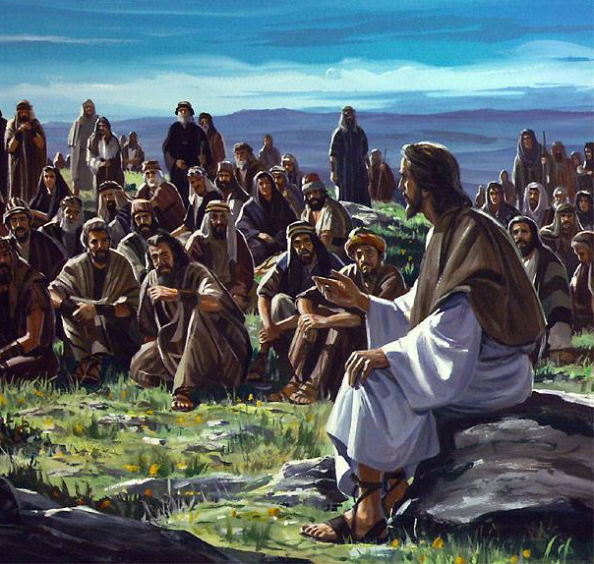
Jesus’ Ministry Years (about 3 years)
Age: late 20s to early 30s.
Beginning with his first miracle turning water into wine in Cana, Galilee
His ministry in Galilee
His ministry around Galilee
His Judean ministry
His ministry in and around Perea
His final entry into Jerusalem
Notes:
Period 4: Jesus’ Ministry Years (about 3 years)
Age: late 20s to early 30s.
Beginning with his first miracle turning water into wine in Cana, Galilee
His ministry in Galilee
His ministry around Galilee
His Judean ministry
His ministry in and around Perea
His final entry into Jerusalem

Slide 25
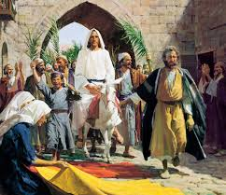
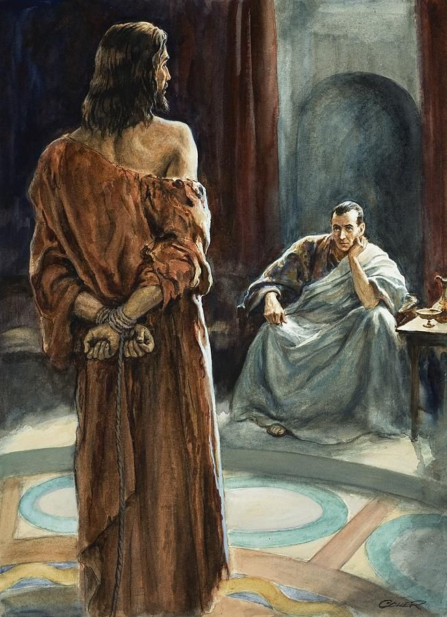
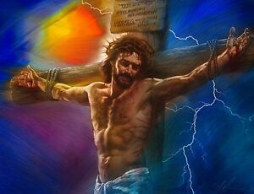
JESUS’ PASSION WEEK & CRUCIFIXION
Notes:
Period 5: Jesus’ Passion Week and Crucifixion.
“Passion” = Gr. pascho = to suffer
Age: Early 30s.
Begins with: The last supper (Correction “Triumphal Entry, Palm Sunday)
Good Friday: Six illegal trials
Ends with: Jesus’ death on the cross

Slide 26
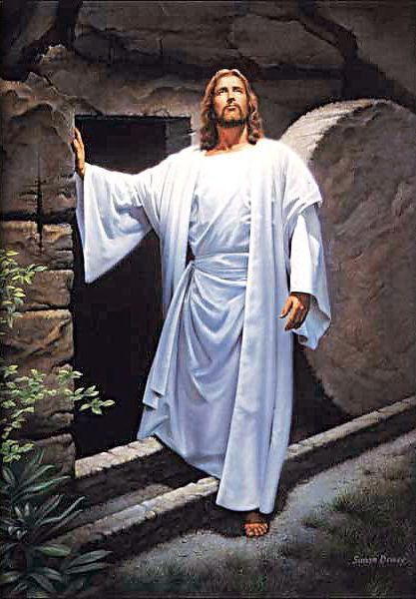
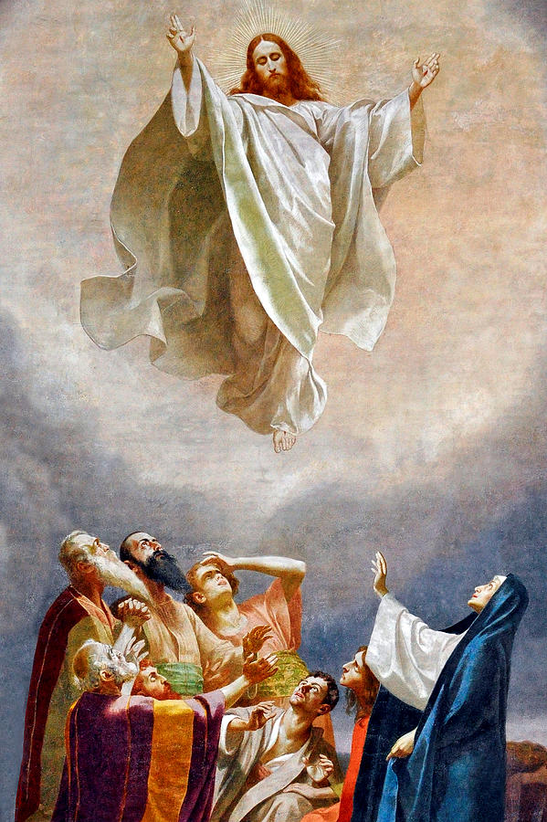
JESUS’ POST-RESURRECTION MINISTRY & ASCENSION
Notes:
Period 6: Jesus’ Post-Resurrection Ministry and Ascension.
Begins with: Jesus’ resurrection (Easter Sunday)
Appears to over 500 people over 40 days
Ends with: Jesus’ ascension to heaven

Slide 27
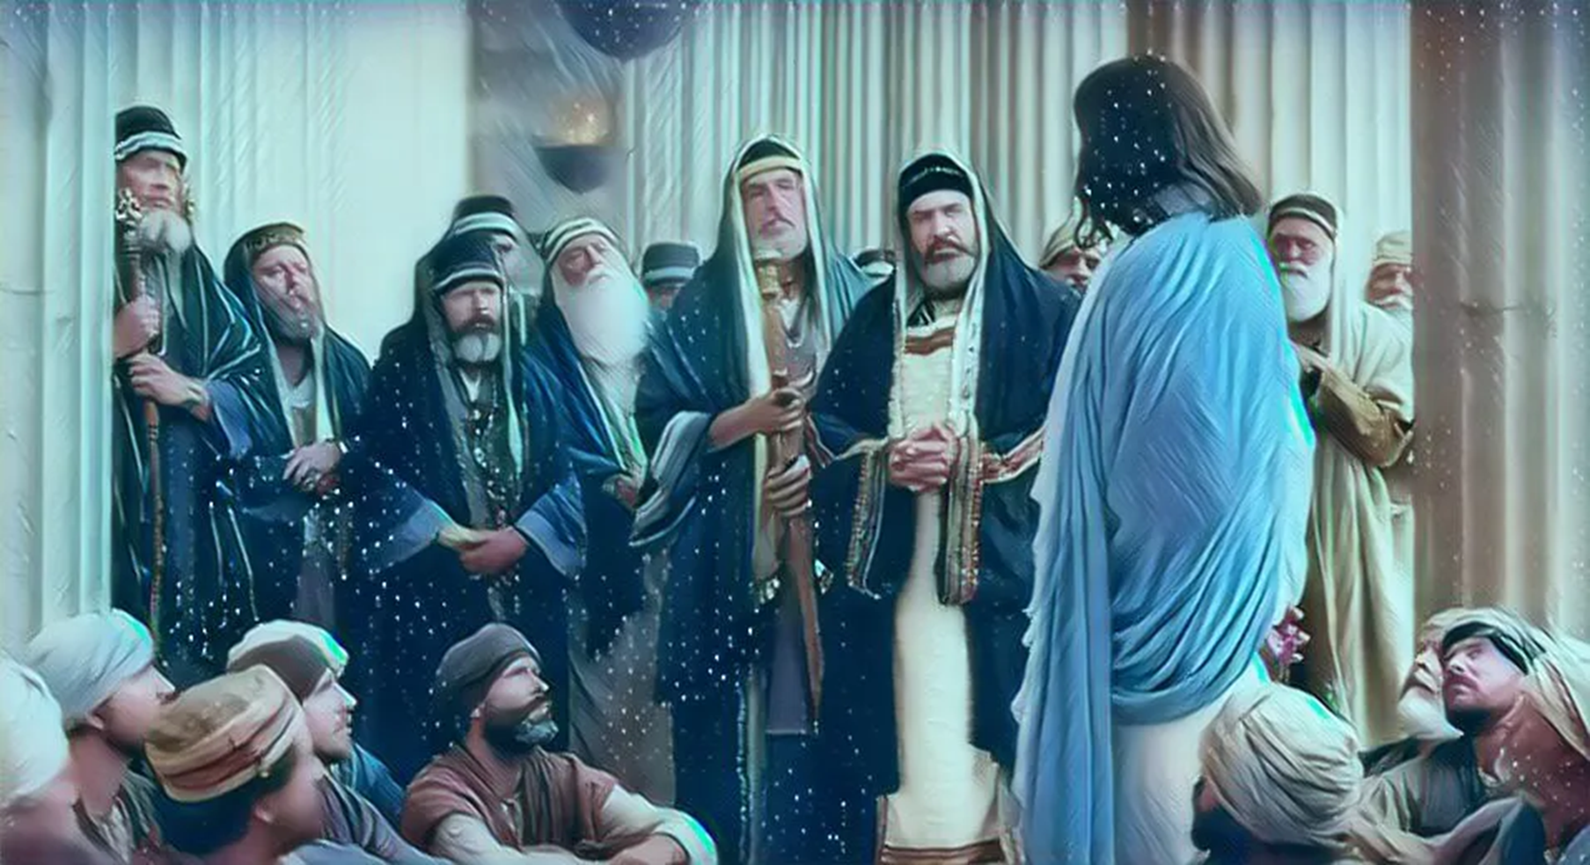

Slide 28
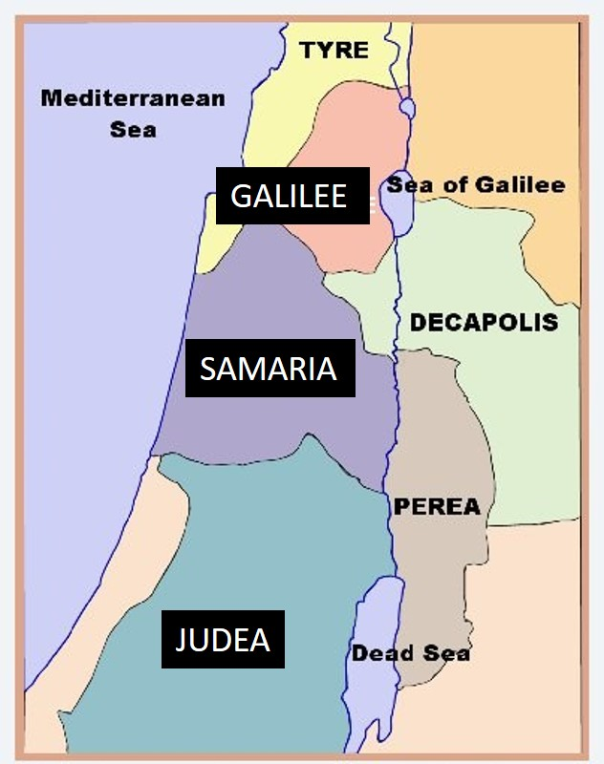
GALILEE
Palestine consisted of three distinct cultures
SAMARIA
JUDEA
Notes:
GALILEE
Generally receptive and friendly to Jesus
Somewhat like Lake Tahoe area.
Pleasant rural area with mixed Jewish and Gentile cultures.
Roman soldiers R & R
SAMARIA
Suspicious but receptive of Jesus
Mixed race of Jews and Assyrians.
Hated by Jews.
Wilderness area, rocky and treacherous.
JUDEA
Mixed reception of Jesus, opposition from Jewish leaders
Jerusalem: Power center of Judaism.
Location of 2nd Temple, Pharisees, Scribes
The Great Sanhedrin (70 men + High Priest)

Slide 29
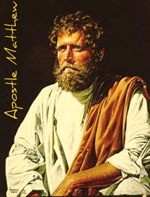
MAIN POINT
Jesus is the long-awaited Messiah prophesied throughout the Old Testament!
MATTHEW
Notes:
MATTHEW
Rich
About same age as Jesus and Paul
Main Point: Jesus is the long-awaited Messiah prophesied throughout the Old Testament!
Profession: Tax collector (“publican”) for Roman government
Name: Matthew Levi
Social standing:…despised by fellow Jews
Great example of faith…followed Jesus with no hesitation.

Slide 30
WHAT TO LOOK FOR IN THIS BOOK
Matthew is like a bridge between the OT and the NT
O.T.
The Messiah/King will come
Kingdom is coming
New Covenant is coming
Mosaic Law followed
N.T.
The Messiah/King has come
Kingdom is here
New Covenant is here
Mosaic Law fulfilled
Notes:
What to Look for in this book
Matthew is like a bridge between the Old Testament and the New Testament. He did this by quoting over 60 OT passages, mostly Isaiah, to show how Jesus fulfilled these prophecies.
Mathew wanted to show his fellow Jews that Jesus is the Messiah.
Matthew contains five teaching sessions by Jesus, called “discourses (centering on God’s Kingdom)
Discourse #1: The Sermon on the Mount (5:1--7:29).
Discourse #2: The commission and instruction of the disciples for kingdom ministry to Israel (10:11-42).
Discourse #3: Parables on the mysteries of the kingdom (13:1-52).
Discourse #4: Behavior in the community of believers (18:1-35).
Discourse #5: Olivet Discourse: The King's triumphant coming (23:1; 24:1--25:46).

Slide 31
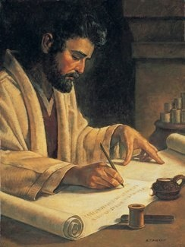
MARK
Main Point
Jesus came to serve, not to be served.
MARK
Notes:
MARK
Main Point: Jesus came to serve, not to be served.
What to Look for in this Book
Observe the frequent use of the word "and."
This reveals Mark's vivid, rapid-fire style of writing which encourages the reader to digest the entire book in one setting.
Writes to Romans who were interested more in ACTIONS than WORDS.
It's hard to lay the book down once started.
Notice how Mark shows that the time of God’s rule, the Kingdom of God, has come with Jesus.
Examine how Jesus has come as the Servant King to serve others not to be served, and to give his life as a ransom.
Discover what it means to a disciple of Jesus is by letting him be in complete control of your life.
Note how Jesus’ humanity is presented in addition to his deity.
His sorrow (14:34), his being displeased (10:14), his anger (11:15-17), his amazement (6:6), and his fatigue (4:38).

Slide 32
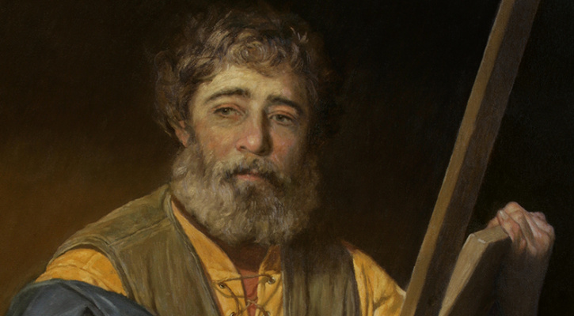
Main Point
Jesus is the Son of Man (emphasizing his humanity)
Dr. LUKE
Notes:
LUKE
Educated (studied medicine at school in Tarsus)
Extensive vocabulary
Traveled with Paul…gave medical help to him
Loved history and literature
Felt compassion for the sick and poor
Main Point: Jesus is the Son of Man (emphasizing his humanity)
Jesus’ humanity…he understands us and experiences life like we do
Only Gentile writer of NT/Bible
Although Luke is considered likely to have been a gentile Christian, some scholars believe him to have been a Hellenized Jew.
What to Look for in this Book
Notice Luke's way of compassionately showing how the gospel is for all people including the marginalized of society--the poor, the crippled, the lame, the blind, a despised Samaritan, and women.
Watch how God’s Messiah has come to his people, Israel, with the promised inclusion of Gentiles.
Notice too how Luke traces Jesus’ ministry from his birth to the final climax of his crucifixion in Jerusalem.
Observe Luke's unique way of using contrasts--the rich/poor, and the humble/proud, etc.
Note how Luke describes Jesus’ ministry as being carried out under the power of the Holy Spirit, and the necessity of his death and resurrection (fulfilling Old Testament prophecies) for the forgiveness of sins.

Slide 33
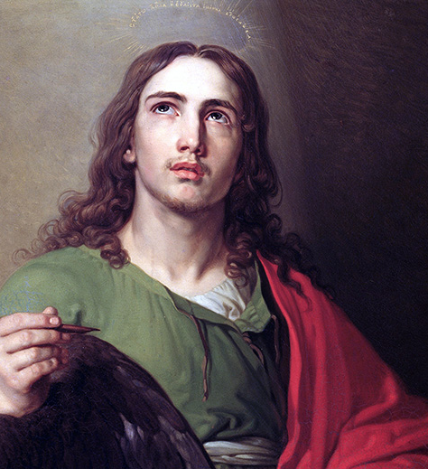
Main Point
Jesus is the Son of God (emphasizing his deity)!
JOHN
Notes:
JOHN
Easy to understand writing style
Youngest of Jesus’ disciples
Main Point: Jesus is the Son of God (emphasizing his deity)
More than just a great teacher
What to Look for in this Book
Notice in Matthew and Luke, “Son of David” and “Son of Man” show the divine connection between Jesus and mankind (horizontal). In John, “Son of God” connects him with the Father in heaven (vertical).
Note in this Gospel that Jesus proclaims that he is God, that he is the “I am.” (cp. Exodus 3:6; John 8:58).
Exod. 3:14: God said to Moses, "I AM WHO I AM. This is what you are to say to the Israelites: 'I AM has sent me to you.'" (Exod. 3:14 NIV)
Carefully read the dialog between Jesus and Nicodemus as it provides one of the clearest definitions of salvation and what man must do to be saved from the penalty of sin (John 3).
Notice Jesus' self-identification as the "I am" throughout this Gospel, especially in Chapter 8.
Observe how John explains that “fruit-bearing" happens only when a follower “remains in the Vine” (Jesus).
).

Slide 34
NEXT WEEK
Browse through
Acts, Romans, 1, 2 Corinthians

