Slide 1
NEW TESTAMENT SURVEY
PART 5
1, 2 Thessalonians
1, 2 Timothy

Slide 2
Please mute your mic until you are ready to speak. Thanks
…to speak, press and hold the space bar.
Notes:
Thanks for muting yourself…to speak, press and hold the space bar

Slide 3
Please sign in each week
George Thompson
Betty White
Warren Willsby
Ed Asner
Sue Thompson
Don Schultz
Please type in your name each week
CHAT BOX
Notes:
Please type in your name each week (credit toward certificate)
Handouts (me)

Slide 4
INTRODUCE YOURSELF
“Should we stay on Daylight Savings Time?
Why or why not”
3 Minutes
Notes:
INTRODUCE YOURSELF
“Should we stay on Daylight Savings Time? Why or why not”
3 Minutes

Slide 5
Please take out your notes
TaylorNotes.Info/abt
Notes:
Please take out your notes.

Slide 6
TONIGHT
What happens to people who die before Jesus returns?
What will happen just before Jesus returns?
Should I listen to other people who say they speak for God?
Notes:
TONIGHT
What happens to people who die before Jesus returns?
What will happen just before Jesus returns?
Should I listen to other people who say they speak for God?

Slide 7
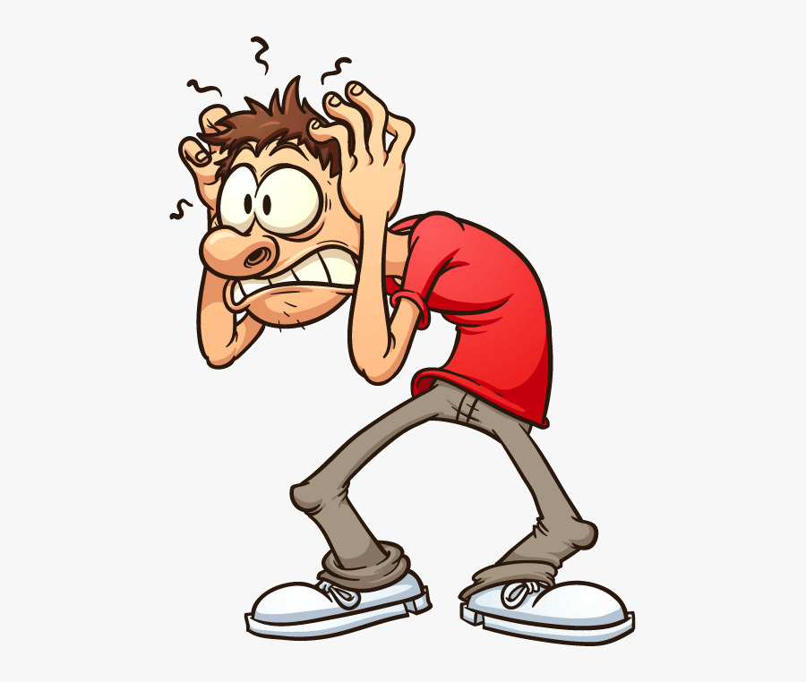
Notes:
QUIZ

Slide 8
What two things was the church in Galatia struggling with?
Christianity + Grace
Grace + Law
Salvation + Grace
Choir Robes + Pew Seats
Gnosticism + Freedom

Slide 9
Galatia was…?
Restaurant in Turkey
Caesar’s favorite sport
City in Turkey
An area in Turkey
Roman god in Turkey

Slide 10
Paul was joyful while in prison because?
He was avoiding his mother-in-law
He was crazy
He saw how God was working
His cell phone had four bars
He got to meet new friends

Slide 11
Which of the following promoted salvation based on works in the early church?
Judaizers
Roman soccer players
Old Testament Prophets
Political action committees
Roman javelin throwers

Slide 12
What is the correct way to spell Thessalonians?
Tessalonians
Thezzalonians
Thessonians
Fresnolonians
Thessalonians

Slide 13
1 Thessalonians
Notes:
Purpose of letter: Clarify misunderstanding about Jesus Christ’s 2nd Coming

Slide 14
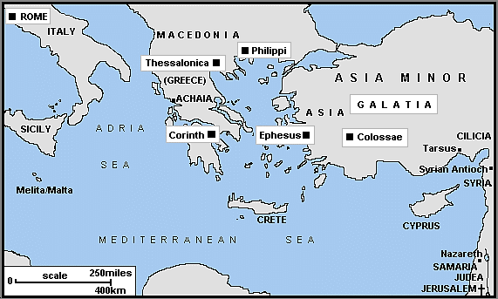
Notes:
Paul writing from Corinth in AD 51
THESSALONICA
Chief sea port under Roman rule.
City surrounded by a wall.
Population was mostly Roman, with Jewish colony.
BACKGROUND
Church was only 2-3 years old.
Most likely Gentiles—turned from idols (1:9)
Paul established this church on 2nd missionary journey.
Paul’s life was threatened in Thessalonica—Judaizers stirred up crowd--his Christian friends got him out of town.
Later, Paul sends Timothy back to see how the church is doing.
Letter written short time after his visit—Timothy’s report was favorable.
Probably never visited this church again
Why did Judaizers oppose Jesus?
Felt the gospel would destroy their national identity based on Mosaic Law
The gospel undermined their political position
Felt Jesus was a false prophet
Didn’t want his teachings to get around

Slide 15
MAIN POINT
At King Jesus’ future coming, believers who have died will physically rise and will be caught up (raptured), along with living believers, to meet the Lord in the air and to be with him forever.
Notes:
MAIN POINT
At King Jesus’ future coming, believers who have died will physically rise and will be caught up (raptured), along with living believers, to meet the Lord in the air and to be with him forever.

Slide 16
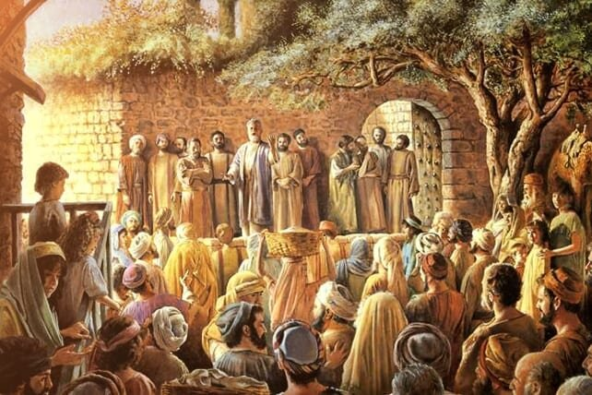
The Thessalonians
Were spiritually young Christians
Were worried about fellow Christians who had “fallen asleep”
Were being persecuted by Judaizers
Notes:
BRIEF DESCRIPTION OF THE BOOK
They were spiritually young Christians
(~5 years old)
They were worried about fellow Christians who had “fallen asleep”
Thought they would not go to heaven if they died before Jesus returned
They were being persecuted by Judaizers
Being forced to keep the Law (legalism)

Slide 17
The big problem
He didn’t make it
Notes:
THE BIG PROBLEM
Believed that Christians who died before Jesus came back would not go to heaven.
1 Thess. 4:13 “Brothers, we do not want you to be ignorant about those who fall asleep, or to grieve like the rest of men, who have no hope.”
Gr. [Κοι μά ομαι] a common word for "sleep," was often used as a euphemism for death in Greek, Jewish, and Christian writings as well as in Paul's epistles.
Much like our term “pass away” or “passed” for death
Next slide →

Slide 18
1 Thessalonians 4:14-18 NIV
" For we believe that Jesus died and rose again, and so we believe that God will bring with Jesus those who have fallen asleep in him. ¹⁵ According to the Lord's word, we tell you that we who are still alive, who are left until the coming of the Lord, will certainly not precede those who have fallen asleep.
¹⁶ For the Lord himself will come down from heaven, with a loud command, with the voice of the archangel and with the trumpet call of God, and the dead in Christ will rise first. ¹⁷ After that, we who are still alive and are left will be caught up together with them in the clouds to meet the Lord in the air. And so we will be with the Lord forever. ¹⁸ Therefore encourage one another with these words.“
Notes:
1 Thess. 4:14-18
"For we believe that Jesus died and rose again, and so we believe that God will bring with Jesus those who have fallen asleep in him. ¹⁵ According to the Lord's word, we tell you that we who are still alive, who are left until the coming of the Lord, will certainly not precede those who have fallen asleep. ¹⁶ For the Lord himself will come down from heaven, with a loud command, with the voice of the archangel and with the trumpet call of God, and the dead in Christ will rise first. ¹⁷ After that, we who are still alive and are left will be caught up together with them in the clouds to meet the Lord in the air. And so we will be with the Lord forever. ¹⁸ Therefore encourage one another with these words." (1 Thess. 4:14-18 NIV)

Slide 19
What happens when you die?
Notes:
Thessalonian Christians were confused about what happens when you die
This same problem exists today
Mistaken views vs. what Bible says → Next slides

Slide 20
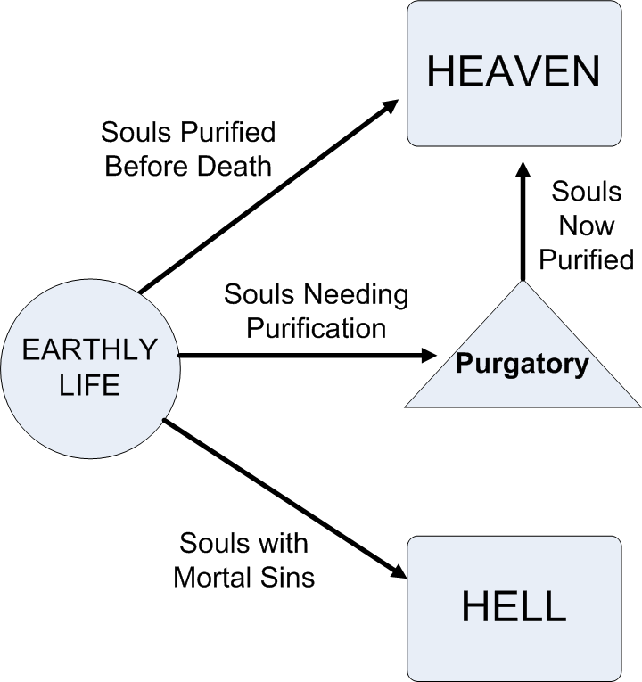
Roman Catholic
View
Death
Notes:
RC View: When people die some go to purgatory
A place where souls are made pure through suffering before going to heaven.
First established by Pope Gregory I, about AD 600.
Pope Gregory I was more of an administrator than a theologian
Roman Catholics base the concept on 2 Maccabees 12:43-45.
Related RC doctrine
Praying for the dead
Indulgences (sinners reduced time in purgatory by good works and prayers priest draws from a “treasury of merit”).
The concept of Purgatory fails to recognize that Jesus’ death was sufficient to pay the penalty for ALL of our sins.
“Mortal sins” (vs. venial sins)
Murder, rape, incest, adultery, complete turning away from God.
Can be restored by doing penance (voluntary self-punishment inflicted as an outward expression of repentance for having done wrong).

Slide 21
Jehovah’s Witness View
Heaven
(144,000 Max.)
Future Resurrection
Death
zzzz
Earth
(All other JWs)
Annihilated
Notes:
JEHOVAH’s WITNESSES
Soul remains unconscious (“sleep”) until a future resurrection
HEAVEN
Earned by “door to door” work
144,000 live as spirits in heaven (now full)
All other JWs will live on earth but must obey God perfectly for 1,000 years or be annihilated

Slide 22
Mormon View
Celestial Kingdom (Mormons)
PARADISE
(Mormons only)
Terrestrial Kingdom
Death
“SPIRIT PRISION (Non Mormons)
“Outer Perdition” (Satan + followers)
Telestial
Kingdom
Notes:
Mormonism:
When a faithful Mormon dies he/she goes to “paradise”
Non-Mormons go to a “spirit prison”
Both stay there until the Day of Judgment
Eventually everyone goes to one of three “heavenly” kingdoms, with some achieving godhood.
Celestial: Those faithful to Mormon leaders and Mormonism (good works)
Terrestrial: Good people…who are not Mormons
Telestial: Bad people…who are not Mormons
Outer darkness: Satan, his followers and those who forsake Mormonism (apostates) and murderers go to “outer darkness”
This is not what Paul meant by going to the “third heaven” in 2 Corinthians 12:2
The Mormon view is NOT based on scripture but on the writings of Joseph Smith, and later modified by Brigham Young

Slide 23
Islamic View
Paradise
Death
Day of Judgment (Allah)
Hell
Notes:
Islam: All remain in the grave until the Day of Judgment (Allah)
Muslims with adequate good deeds go to Paradise (w/ maidens designed by Allah to provide sexual pleasures to righteous men)
Non-Muslims, or those without enough good deeds, go to Hell

Slide 24
BIBLICAL VIEW (BELIEVERS)
Physical death
Christ’s Return
1 Thess. 4:16-17
Heaven
Spiritual Body
Glorified State
1 Thess. 5:23
Soul/Spirit
2 Cor. 5:8
1 John 3:2
1 Cor. 15:49
Phil. 3:20-21
Physical body
Grave
Physical body
1 Cor. 15:44
Note: The path for OT saints and unbelievers will be covered in Christianity II
Notes:
BIBLICAL VIEW (NT BELIEVERS) → others are covered in Christianity II
At death the body goes into the grave
Soul goes immediately to heaven
In 2 Cor. 5:8, "we are of good courage, I say, and prefer rather to be absent from the body and to be at home with the Lord." Paul is clearly telling us that when he dies, he will go and be with the Lord.
Furthermore, at the Transfiguration of Jesus (Matt. 17:1-8) we see Moses and Elijah who were alive. There was no soul sleep with them.
Luke 23:43 The thief on the cross, “Jesus answered him, "I tell you the truth, today you will be with me in paradise.“
Rev. 6:11 Given white robes…intermediate state…probably some physical form
Christ’s return ( 1 Thess. 4:16-17)
New body (Phil. 3:20-21)

Slide 25
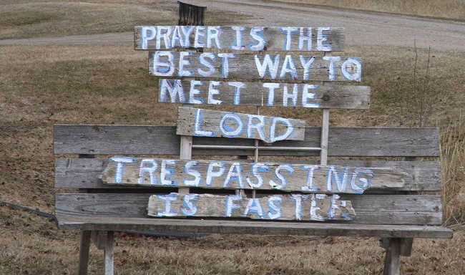
Trespasser View
Notes:
Prayer is the best way to meet the Lord…trespassing is faster!
In heaven…”all I remember is we got lost and went down this strange road.”

Slide 26
2 Thessalonians
Notes:
2 Thessalonians

Slide 27
MAIN POINT
The return of King Jesus will be preceded by an “apostasy” (rebellion) and by the revealing of the man of lawlessness, the Antichrist.
Notes:
MAIN POINT
The return of King Jesus will be preceded by an “apostasy” (rebellion) and by the revealing of the man of lawlessness, the Antichrist

Slide 28
WHAT TO LOOK FOR IN THIS BOOK
Paul comes across as being a little upset
The day of the Lord will not take place until the rebellion led by the “man of lawlessness” occurs
This behavior was probably because of the general dislike for manual labor on the part of Greek aristocracy
Notes:
BRIEF DESCRIPTION OF THE BOOK (2 Thess)
Paul comes across as being a little upset in this brief letter, the warmth of feeling expressed in 1 Thessalonians is lacking. Why?
First, because someone (ostensibly using Paul’s authority) had misled these Christians into thinking that Jesus already returned (2:2).
Second, he is miffed at those who are still idle and disruptive, a problem he already addressed in his first letter to them (1 Thess. 4:9-12; 5:14).
Paul explains that the day of the Lord will not take place until the rebellion led by the “man of lawlessness” occurs (2:3-4).
The word “rebellion” means apostasy (Gr. apostasia) referring to the deliberate denial of beliefs once formerly held.
The “man of lawlessness” may very well be the Antichrist (I John 2:18; 4:3; 2 John 1:7).
This behavior was probably not because of being misled about Jesus' second coming but because of the general dislike for manual labor on the part of Greek aristocracy.
He instructs the church on how to deal with these idle/disruptive individuals (3:14-15).

Slide 29
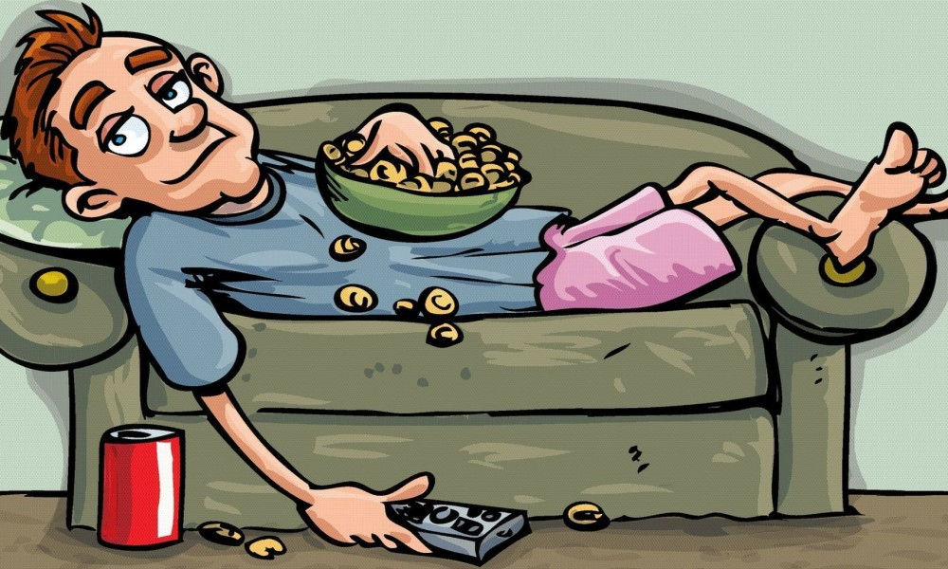
Jesus is coming back at any moment so why should I work?!
Notes:
2 THESSALONIANS
Problem: Jesus is coming back at any moment so why should I work?!
READ 2 Thess. 3:6. In the name of the Lord Jesus Christ, we command you, brothers, to keep away from every brother who is idle and does not live according to the teaching you received from us.
→Next slide

Slide 30
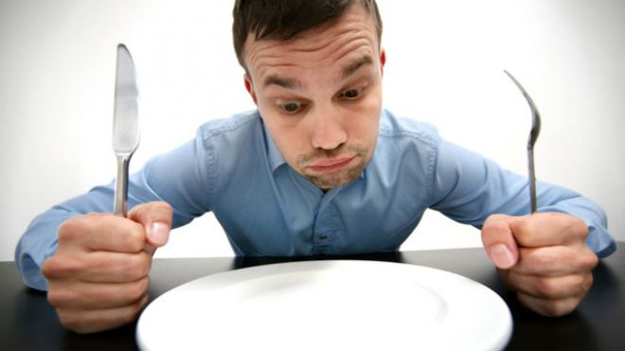
You don’t work… you don’t eat!
Notes:
Paul’s Response 2 Thess. 3:10
READ 2 Thess. 3:10 “For even when we were with you, we gave you this rule: "If a man will not work, he shall not eat.“
Rest and relaxation are vital to stay healthy but laziness is to be avoided.

Slide 31
1 Timothy
Notes:
1 TIMOTHY
This letter is written from Paul (in prison) to Timothy (in Ephesus) about how to be a good pastor

Slide 32
MAIN POINT
The gospel leads to practical, visible change in the lives of those who believe it and obey it.
Notes:
MAIN POINT (1 Tim)
The gospel leads to practical, visible change in the lives of those who believe it and obey it.

Slide 33
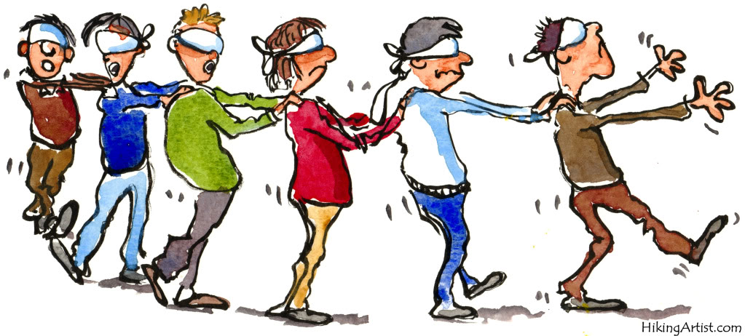
False teachers were leading some house churches astray
Notes:
BRIEF DESCRIPTION OF THE BOOK (1 Tim)
The letters Paul writes to Timothy and Titus are often referred to as pastoral epistles
In this first letter to Timothy he issues a charge against false teachers
their character and their teachings
instructing him on how to deal with the crisis these false teachers created in the church community.
He also brings encouraging words to this young pastor who is most likely working in the church at Ephesus.
These false teachers were probably local elders who were leading some house churches astray.
They were most likely a mixture of Jews and Gentiles, insisting on following the law (1:7), practicing asceticism and denying the goodness of creation (4:3-5).

Slide 34
“I will mediate between God and you and tell you what you must do!”
Notes:
Q: How do you feel about this statement?
“I will mediate between God and you and tell you what you must do!”
Q: What does 1 Tim. 2:5 say about this?

Slide 35
2 Timothy
Notes:
2 TIMOTHY

Slide 36
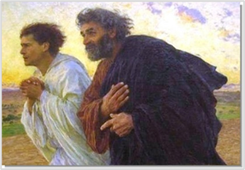
Notes:
WHO WAS TIMOTHY?
Paul’s companion on many of his journeys
Half Jew (mother), half Greek (father)
Probably converted by Paul
Paul’s “spiritual son”
Mentoring so important
Timid but faithful
Probably pastored church in Ephesus
Paul left a legacy in Timothy

Slide 37
MAIN POINT
Persevere in the gospel in spite of suffering… continue the fight of faith until God calls you home
Notes:
MAIN POINT (2 Tim)
Persevere in the gospel in spite of suffering…continue the fight of faith until God calls you home

Slide 38
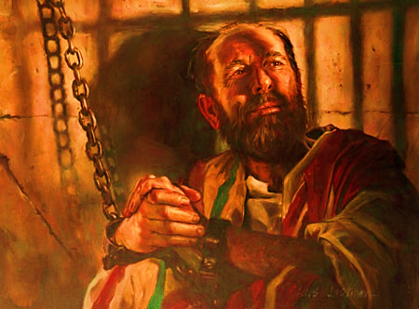
Paul is in Rome awaiting execution
His final letter
His trial is coming up soon
Urgent letter to Timothy to join him ASAP
The letter was written to encourage and strengthen Timothy
Notes:
Paul is in Rome awaiting execution
His trial is coming up soon
Urgent letter to Timothy to join him ASAP
The letter was written to encourage and strengthen Timothy

Slide 39
Notes:
PAUL
Before conversion
Paul was a pure Jew born around A.D. 5, and lived until his execution in A.D. 67.
from the elite tribe of Benjamin.
He was a Hebrew of the Hebrews meaning he had Hebrew parents and did not take up the Hellenistic culture as some dispersed Jews had done.
He was a Jew who still spoke Hebrew (Acts 21:40).
He was a trained Pharisee (Acts 22:3; 23:6; 26:5)
he was a zealous Jew being a persecutor of the early Christians.
To Jews zeal was one of the greatest qualities of their religion.
Conversion
Was converted from Judaism on the road to Damascus.
Spent time in Arabia and Damascus before his first visit to Jerusalem (Gal. 1:16-19).
Paul’s Missionary Journey
First and greatest missionary of all times
Three missionary journeys.
Started churches (young, met in synagogues and homes)
Beaten several times, once left for dead.
Often cold and hungry while traveling
Ship wrecked
Spent a night day in open sea
Hassled by Judaizers
Imprisoned, house arrest for years
Executed for in AD 64

Slide 40
For Next Week
Read
Titus, Philemon, Hebrews, James
Notes:
For next week…
Read 1, 2 Thessalonians
Read 1,2 Timothy

Slide 41
Ron Eddow

