Slide 1
PRIME TIME
Welcome

Slide 2
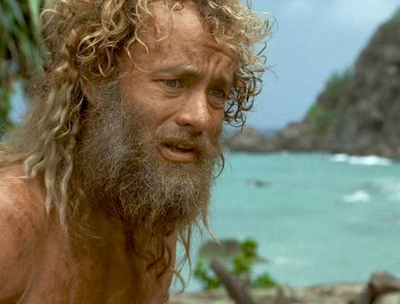
Notes:
Many years ago the only remaining Apostle, John, was banished to a remote island in the Mediterranean Sea for preaching the good news of Jesus Christ.
John the Apostle was like Tom Hanks in Cast Away
Perhaps the only surviving apostle.
He along with Peter, and James were the inner three and closest to Christ.
According to tradition, the Roman Emperor Domitian banished John from Ephesus to Patmos because he refused to stop preaching the gospel in Ephesus.
He was preaching Jesus as Lord and King…Domitian was insulted that anyone could think of a king other than himself.

Slide 3
Notes:
Many years ago the only remaining Apostle, John, was banished to a remote island in the Mediterranean Sea for preaching the good news of Jesus Christ.

Slide 4
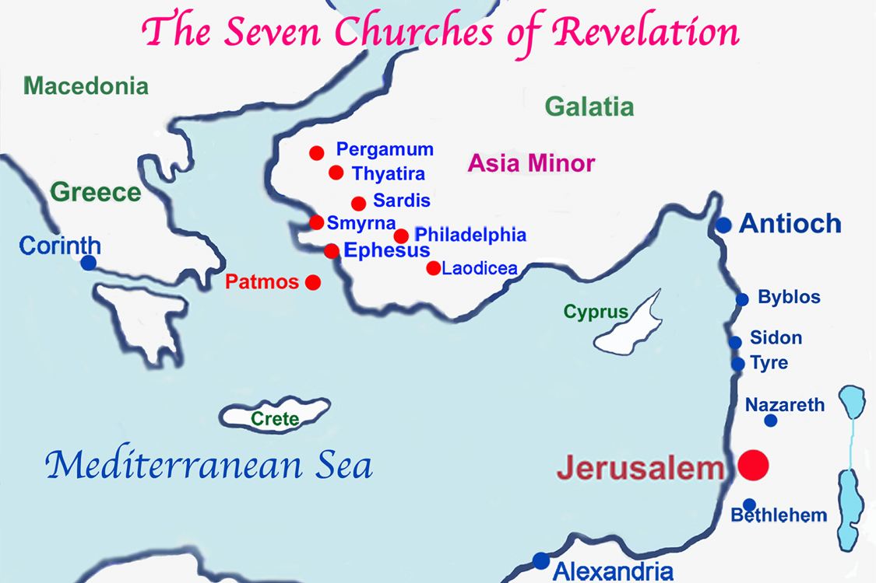
Notes:
MAP: Patmos is a small rocky island in the Aegean Sea about 50 miles offshore from the city of Ephesus

Slide 5
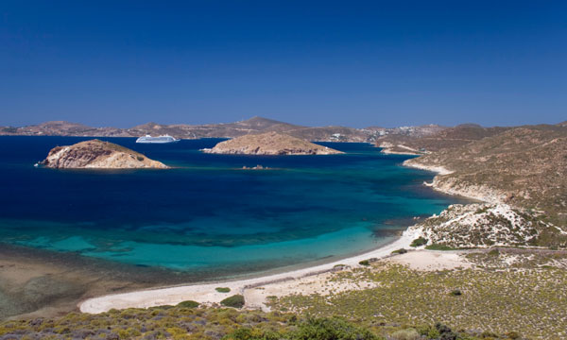
Notes:
PATMOS ISLAND
10 x 6 miles
Criminals were banished there
Forced to work at hard labor in the mines and quarries
John probably suffered from harsh treatment
Tradition → He was there for 1 ½ years
Rocky and almost treeless with many volcanic hills rising as high as 900 feet
John probably lived in a cave
It was here that God gave John the revelation of Jesus Christ to reveal the things that must soon take place.” Rev 1:1 (ESV)
Today, the island is known as Patino. Population today about 3,000

Slide 6
REVELATION
PART 1: INTRODUCTION
Notes:
HANDOUTS

Slide 7
REVELATION
Main Idea
Background
Interpretive Challenges
Outline
How to Understand Revelation
Discussion Questions
Notes:
REVELATION (Your notes)

Slide 8
WHY STUDY REVELATION?

Slide 9
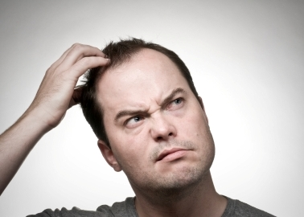
The beast out of the sea?
Big red dragon?
Woman clothed with the sun?
The beast out of the earth?
144,000?
Seven seals, seven bowls, seven trumpets
Notes:
REVELATION’s SYMBOLS AND ANIMALS CAN MAKE IT A CONFUSING BOOK
The beast out of the sea?
Woman clothed with the sun?
The beast out of the earth?
Big red dragon?
144,000?
Seven seals, seven bowls, seven trumpets?
It is tempting to read INTO Revelation (eisegete)

Slide 10
REVELATION promises a BLESSING!
Notes:
Revelation promises a BLESSING….to encourage you and make you happy!
Blessed is the one who reads the words of this prophecy, and blessed are those who hear it and take to heart what is written in it, because the time is near.” Rev. 1:3
“Blessed” (Gr. makarios) to prosper, to make happy.
→ Next slides

Slide 11
REVELATION puts this life in perspective with the life to come!
Notes:
Revelationputs this life in perspective with the life to come.

Slide 12
REVELATION reveals God’s full and complete plan of the ages!
Notes:
REVELATION reveals God’s full and complete plan of the ages.

Slide 13
REVELATION describes how Satan, chaos, and evil will come to an end when Christ returns
Notes:
REVELATION describes how Satan, chaos, and evil will come to an end when Christ returns.

Slide 14
REVELATION tells you that you have a permanent, eternal home in heaven
Notes:
REVELATION tells you that you have a permanent eternal home in heaven.

Slide 15
Next LESSON
Read Chapter 1

Slide 16
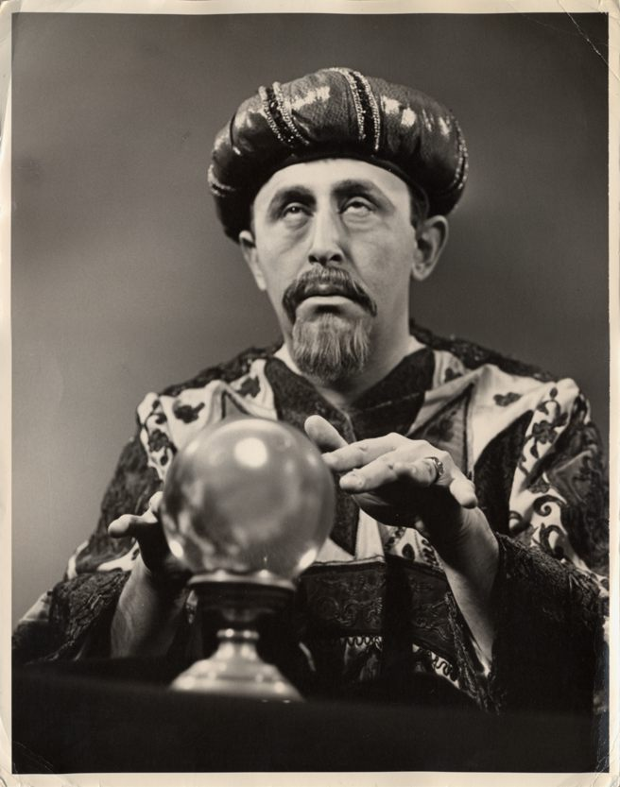
Notes:
Man has always wanted to know the future…
-Crystal ball gazers
-Fortune tellers
-Reading tea leaves
-Soothsayers
-Presidential polls

Slide 17
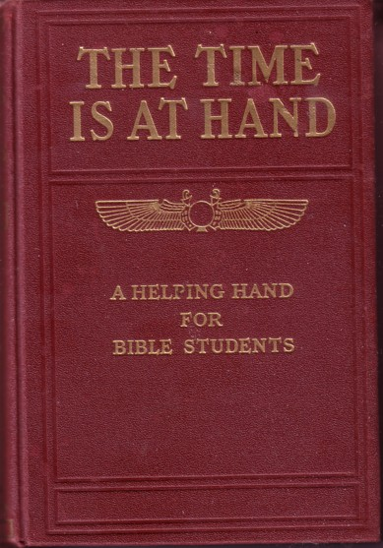
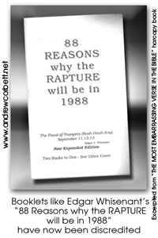
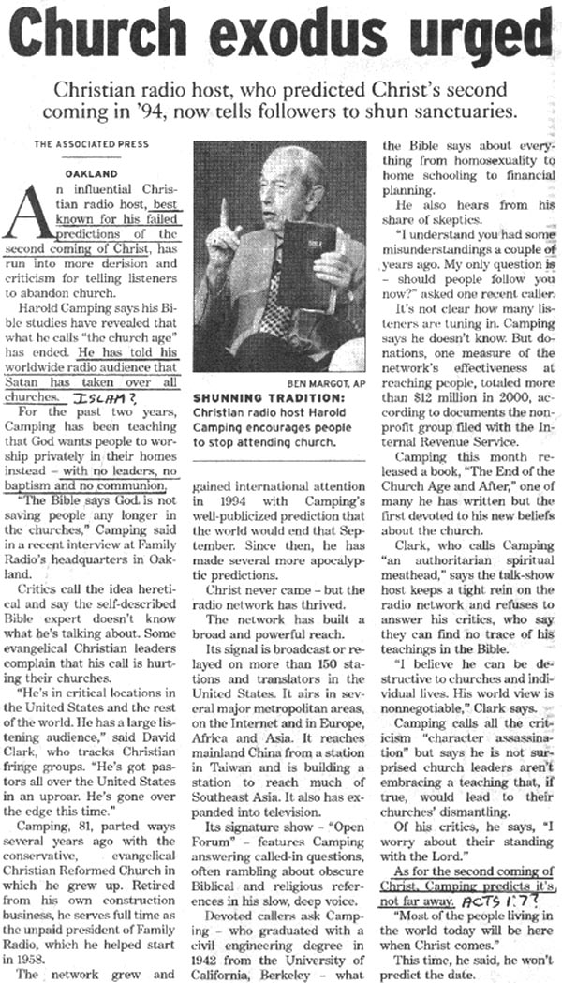
Ooops!
Notes:
Charles Taze Russell,
Founder of the Jehovah's Witnesses, prophesied that the end of the world would occur by the end of 1914.
Edgar E. Whisenant,
A Christian layman, predicted the Rapture of the Church would occur on September 12, 1988.
His booklet, “88 Reasons Why Jesus Will Return in 1988,” sold over four million copies.
He confidently asserted, "Only if the Bible is in error am I wrong."
When the event failed to occur, he issued a new date of either September 1st or 30th, 1989.
Harold Camping
President of the Family Radio Network, set the date for the Lord's return to be in the fall of 1994.
His prediction was based on a complicated mathematical formula that tied the Rapture to the Jewish holiday of Sukkot (Feast of Tabernacles).
He later predicted the Rapture to take place on May 21, 2011.

Slide 18
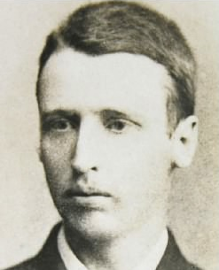
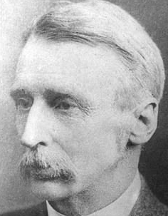
30 Years Old (Today)
$75,000/ year
60 Years old
$243,255/year
Notes:
30 Years old (today) → $75,000/year
60 Years old → $243,255/year

Slide 19
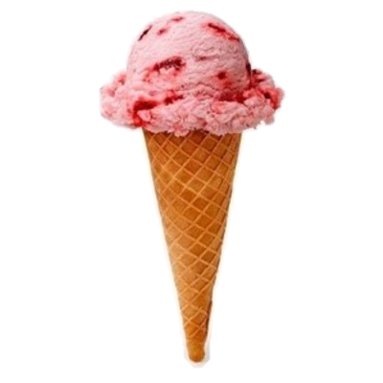
 | TODAY | 2020
GAS | $3 | $9
FOOD | $200 | $326
BALL GAME | $50 | $81
PIZZA | $10 | $16
DINNER | $100 | $163
GYM | $350 | $570
MEDICINE | $100 | $163
DONUTS | $6 | $10
CAR | $25,000 | $40,722
Ice Cream Cone | $3 | FREE!!!!
Notes:
CLICK…CLICK…
GAS
$3….$9
FOOD
$200…$326
BALL GAME
$50…$81
PIZZA
$10…$16
DINNER
$100…$163
GYM
$350…$570
MEDICINE
$100…$163
DONUTS
$6…$10
CAR
$25,000…$40,722
Ice Cream Cone
$3…FREE!!!!

Slide 20
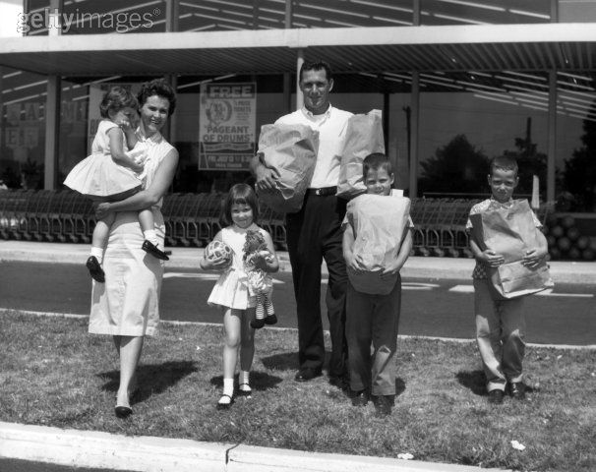
Comments made in the year 1955!
“I'll tell you one thing, if things keep going the way they are, it's going to be impossible to buy a week's groceries for $10.00.”
Notes:
COMMENTS FROM THE YEAR 1955!
“I'll tell you one thing, if things keep going the way they are, it's going to be impossible to buy a week's groceries for $10.00.”

Slide 21
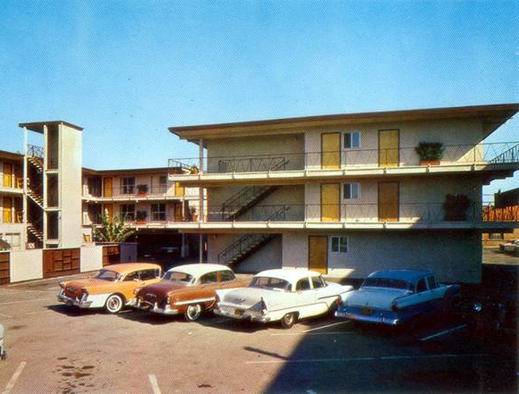
Comments made in the year 1955!
“There is no sense going on short trips anymore for a weekend. It
costs nearly $2.00 a night to stay in a hotel.”
Notes:
COMMENTS FROM THE YEAR 1955!
“There is no sense going on short trips anymore for a weekend. It costs nearly $2.00 a night to stay in a hotel.”

Slide 22
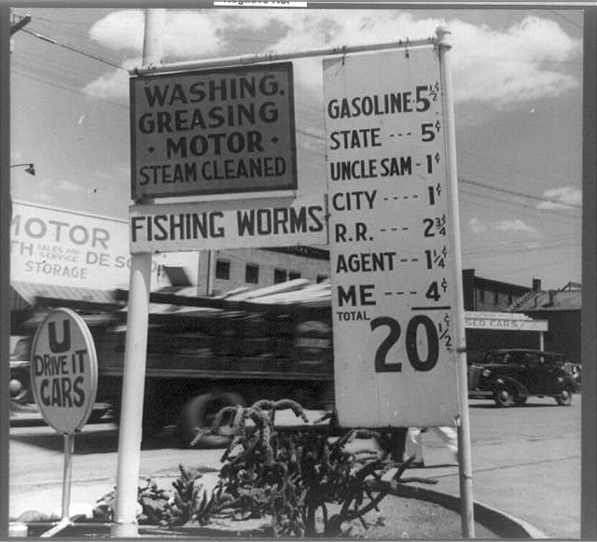
Comments made in the year 1955!
“When I first started driving, who would have thought gas would someday cost 20 cents a gallon.”
Notes:
“When I first started driving, who would have thought gas would someday cost 20 cents a gallon.”

Slide 23
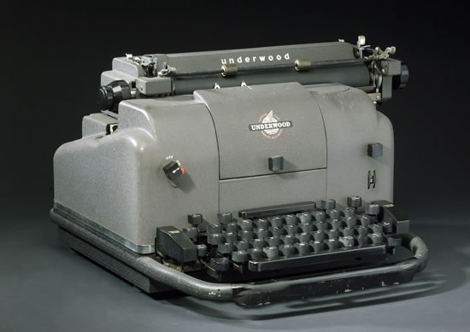
Comments made in the year 1955!
“I never thought I'd see the day all our kitchen appliances would be electric. They're even making electric typewriters now.”
Notes:
“I never thought I'd see the day all our kitchen appliances would be electric. They're even making electric typewriters now.”

Slide 24
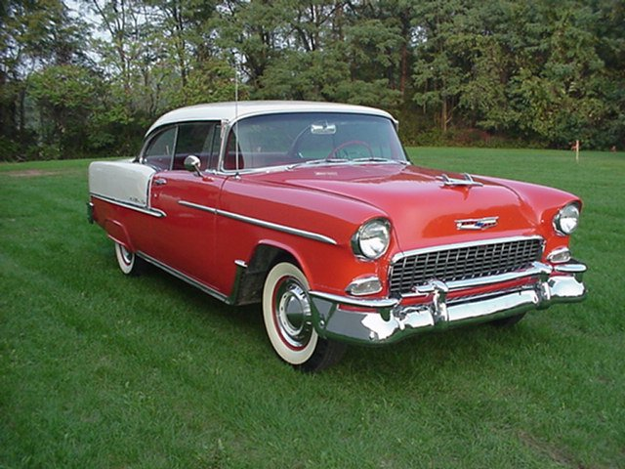
Comments made in the year 1955!
“Have you seen the new cars coming out next year? It won't be long before $1,000 will only buy a used one.”
Notes:
“Have you seen the new cars coming out next year? It won't be long before $1,000 will only buy a used one.”

Slide 25
REVELATION PART 2
MAIN IDEA
SUMMARY
DISCUSSION QUESTIONS
Notes:
Grab your notes.

Slide 26
REVELATION
Part 3: The Letters to the Seven Churches

Slide 27
PAST
What you have seen
Chapter 1
PRESENT
What is now
Chapters 2-3
FUTURE
What will take place later
Chapters 4-22
Notes:
Revelation Outline (Part 1 Notes)

Slide 28
Notes:
SEVEN CHURCHES
The seven messages in Revelation clearly refer to the local churches.
All professing Christians
This explains why some of the messages contain some sharp rebukes and exhortations to repent and be saved according to the true gospel.
Also, it seems evident that some people within those seven churches (such as the “Jezebel” of Thyatira) were not true Christians.
If a courier, starting at the island of Patmos, were to visit these seven churches in order to deliver the epistles from John, he would sail from Patmos to Ephesus, which is the closest.
From there, the closest remaining church is Smyrna to the north. Continuing this simple strategy of visiting the closest remaining church, he would continue north to Pergamum, then east to Thyatira, and back south to Sardis, Philadelphia, and finally ending in Laodicea (which is nearly straight east of Ephesus).

Slide 29
WHY THESE CHURCHES?
Notes:
WHY THESE CHURCHES?
They represent the types of churches that have existed throughout the church age

Slide 30
EPHESUS
REVELATION 2:1-7
Notes:
EPHESUS
Read Revelation 2:1-7
"To the angel¹ of the church in Ephesus write: These are the words of him who holds the seven stars in his right hand and walks among the seven golden lampstands.² I know your deeds, your hard work and your perseverance. I know that you cannot tolerate wicked people, that you have tested those who claim to be apostles but are not, and have found them false.³ You have persevered and have endured hardships for my name, and have not grown weary.⁴ Yet I hold this against you: You have forsaken the love you had at first.⁵ Consider how far you have fallen! Repent and do the things you did at first. If you do not repent, I will come to you and remove your lampstand from its place. ⁶ But you have this in your favor: You hate the practices of the Nicolaitans (followers of Nicholas- taught dualism, antinomianism, immorality is ok), which I also hate.⁷ Whoever has ears, let them hear what the Spirit says to the churches. To the one who is victorious (Christians), I will give the right to eat from the tree of life, which is in the paradise of God.
CLASS?
Main Characteristic? They lost their first love (v. 4)
Praise? They persevered through very difficult times…didn’t tolerate false teachers (vv. 2-3)
Warning? Remove your lampstand (v. 5)…when Christ returns he will treat them like apostate Israel (NIV Study Bible)
Discussion: Do you think Jesus was being too harsh with the church at Ephesus (forsook 1st love) ? Why, or why not?

Slide 31
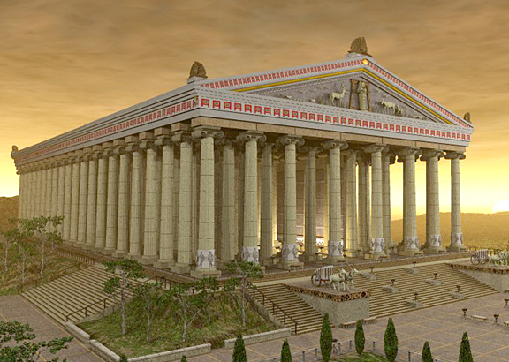
Ancient Ephesus
Notes:
RELIGION OF EPHESUS
It was the center of worship for “Artemis” (Greek name for Roman goddess Diana).
Temple of Artemis ranked as one of the Seven Wonders of the Ancient World.
Artemis (Acts 19:24, 27-28, 34-35—NIV, NASB, NRSV, GNT),
Also called Diana (KJV, NKJ)
The goddess Artemis was the patron of all prostitutes and represented fertility and sexuality.
Ephesus was known for its immorality.
Worshippers of Artemis brought much business to Ephesus (Acts 19:23-27).
Demonism and sorcery were rampant (Acts 19:13-19).

Slide 32
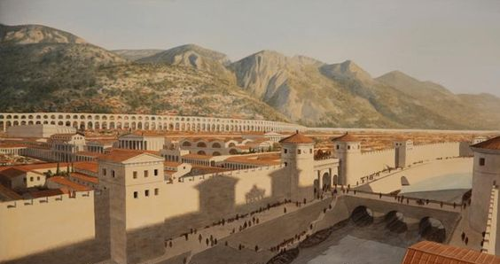
Notes:
One of the largest and most important Greek cities of the Roman Empire.
Size: largest city in Asia (300,000 people).
Most important trade center west of Tarsus, located on a favorable seaport of the river Cayster.
Wealthy city
Was also a banking center because of its great vault in the Temple of Artemis, considered to be the safest vault in Asia Minor
Large library

Slide 33
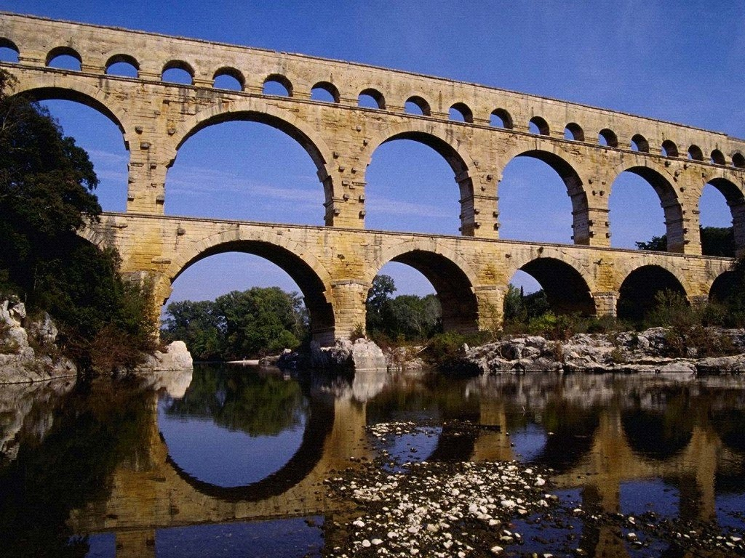
Notes:
Ephesus had one of the most advanced aqueduct systems in the ancient world, with multiple aqueducts of various sizes to supply different areas of the city, including four major aqueducts.
They fed a number of water mills, one of which has been identified as a sawmill for marble.

Slide 34
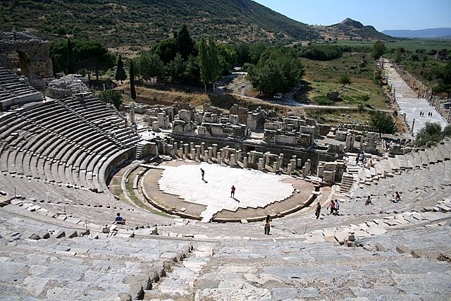
Ancient Ephesus
Notes:
Theatre (Ephesus)
25,000 spectators
Parabolic shape…excellent acoustics

Slide 35
SMYRNA
Revelation 2:8-11
Notes:
READ 2:8-11
"To the angel of the church in Smyrna write: These are the words of him who is the First and the Last, who died and came to life again. 9 I know your afflictions and your poverty-- yet you are rich! I know about the slander of those who say they are Jews and are not, but are a synagogue of Satan (probably Jews who rejected Jesus as the Messiah). 10 Do not be afraid of what you are about to suffer. I tell you, the devil will put some of you in prison to test you, and you will suffer persecution for ten days (brief period). Be faithful, even to the point of death, and I will give you life as your victor's crown.11 Whoever has ears, let them hear what the Spirit says to the churches. The one who is victorious will not be hurt at all by the second death.
CLASS?
Main characteristic? They endured afflictions, poverty, slander (2:9)
Praise? You are rich--they remained faithful (2:9)
Warning? None, except continue to be faithful (2:10)

Slide 36
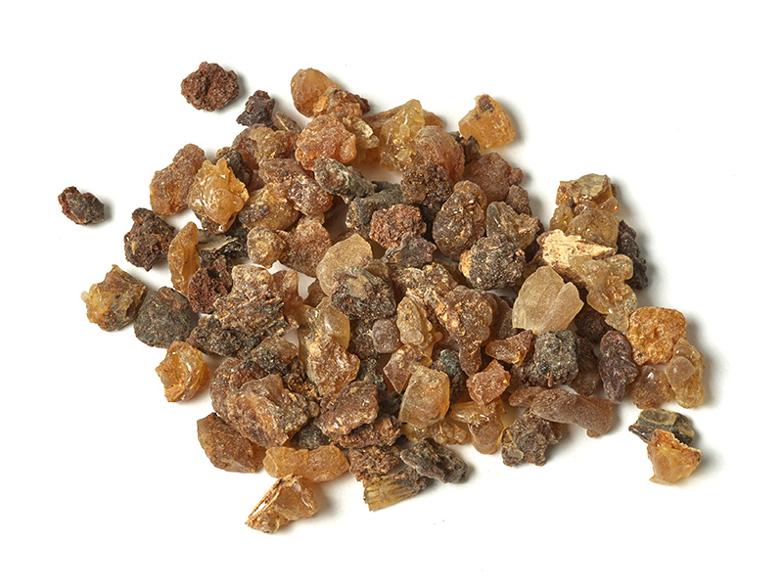
MYRRH
Notes:
Smyrna was known for its myrrh.
“Smyrna” means “myrrh”
Myrrh is a natural gum or resin extracted from a number of small, thorny trees.
Myrrh resin has been used throughout history as a perfume, incense, and medicine.
Myrrh essential oil has been used for thousands of years in traditional healing therapies and in religious ceremonies.
Has anti-inflammatory and antioxidant effects…helps with remaining calm and balanced.

Slide 37
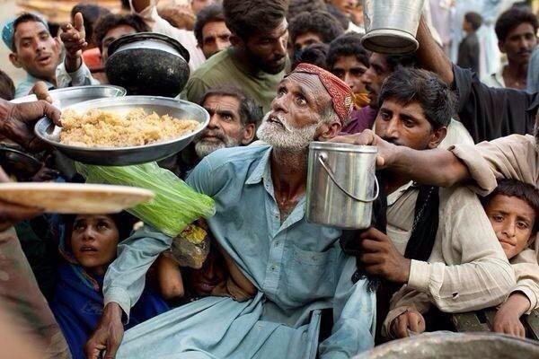
Notes:
Smyrna: The Christians in Smyrna were poor and severely persecuted.
Poor, because they were plundered and deprived of their right to work.
For the most part they possessed little of this earth’s goods.
Christians were given a choice, worship Caesar as Lord or be put to death. They answered “Jesus Christ is Lord, and none other!” As a result many Christians were imprisoned.
Source: Cohen, Gary G and Salem Kirban. Revelation Visualized. Huntingdon Valley, PA: Salem Kirban, Inc., 1971, p. 79.

Slide 38
Pergamum
Revelation 2:12-17
Notes:
Read Rev. 2:12-17 ¹² "To the angel of the church in Pergamum write: These are the words of him who has the sharp, double-edged sword.
¹³ I know where you live-- where Satan has his throne. Yet you remain true to my name. You did not renounce your faith in me, not even in the days of Antipas, my faithful witness, who was put to death in your city-- where Satan lives.
¹⁴ Nevertheless, I have a few things against you: There are some among you who hold to the teaching of Balaam, who taught Balak to entice the Israelites to sin so that they ate food sacrificed to idols and committed sexual immorality. ¹⁵ Likewise, you also have those who hold to the teaching of the Nicolaitans.
¹⁶ Repent therefore! Otherwise, I will soon come to you and will fight against them with the sword of my mouth.¹⁷ Whoever has ears, let them hear what the Spirit says to the churches. To the one who is victorious, I will give some of the hidden manna. I will also give that person a white stone (given to a winning athlete as a pass to the winner’s circle) with a new name written on it, known only to the one who receives it (possibly implies an intimate relationship with Jesus).
CLASS?
Characteristic? They tolerated false teachers-Balaam/Nicolaitans (v. 2:14-15)
Praise? “Did not renounce your faith in me” (v. 2:13)
Warning? Expel these false teachers (implied in vv. 14-16)

Slide 39
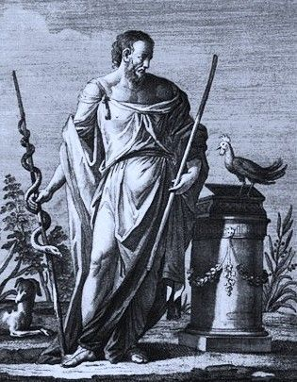
Asclepius considered the god of healing
Notes:
Pergamum:
This city was the center of four cults, Zeus, Dionysus, Asclepius, and Athena
It rivaled Ephesus in its worship of idols.
The city’s chief god was Asclepius (also called Aesculapius by the Romans), whose symbol was a serpent, and who was considered the god of healing.
People came to Pergamum from all over the world to seek healing from this god.
NOTE: The caduceus (☤) is the traditional symbol of Hermes and features two snakes winding around an often winged staff. It is often mistakenly used as a symbol of medicine instead of the Rod of Asclepius, especially in the United States. (Wikipedia)
Life Application Bible. Life Application Bible: New International Version. Wheaton: Tyndale House Publishers and Zondervan Publishing House, 1988, 1989, 1990, 1991; p. 2302.

Slide 40
Thyatira
Rev. 2:18-29
Notes:
THYATIRA
READ Rev. 2:18-29 (NIV)
CLASS?
Main characteristic: You tolerate that woman Jezebel, who calls herself a prophet (2:20)
Praise: I know your deeds, your love and faith, your service and perseverance, and that you are now doing more than you did at first (2:19)
Warning: “Those who commit adultery with her suffer intensely” (2:22)

Slide 41
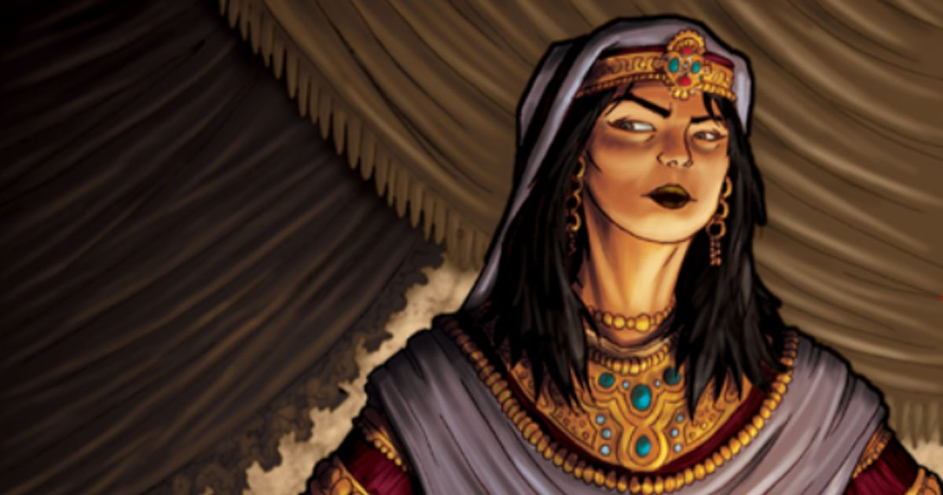
Notes:
Thyatira
Probably a pseudonym for a woman who influenced the church in the way Jezebel influenced the OT Jews into idolatry and immorality.
DISCUSSION: In what ways can immorality creep into the church today?
Source: MacArthur’s Commentary, p. 1998.

Slide 42
Sardis
Rev. 3:1-6
Notes:
SARDIS
Read Rev. 3:1-6 (NIV) "To the angel of the church in Sardis write: These are the words of him who holds the seven spirits² of God and the seven stars. I know your deeds; you have a reputation of being alive, but you are dead. ² Wake up! Strengthen what remains and is about to die, for I have found your deeds unfinished in the sight of my God. ³ Remember, therefore, what you have received and heard; hold it fast, and repent. But if you do not wake up, I will come like a thief, and you will not know at what time I will come to you.
⁴ Yet you have a few people in Sardis who have not soiled their clothes. They will walk with me, dressed in white, for they are worthy. ⁵ The one who is victorious will, like them, be dressed in white. I will never blot out the name of that person from the book of life, but will acknowledge that name before my Father and his angels.⁶ Whoever has ears, let them hear what the Spirit says to the churches.
CLASS?
Main characteristic? you have a reputation of being alive, but you are dead (3:1)
Praise? Yet you have a few people in Sardis who have not soiled their clothes (3:4)—they are still godly people.
Warning? Wake up! “if you do not wake up, I will come like a thief” (3:3)—not the 2nd Coming but swift correction.

Slide 43
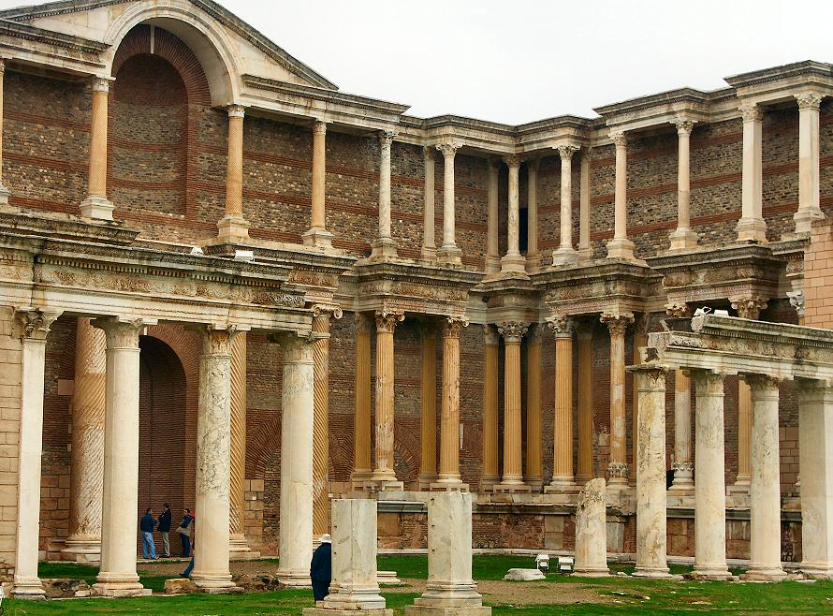
Notes:
Sardis: During its days as a Roman city, Sardis became an important Christian center.
However, the church at Sardis was evidently affected by the complacency of the city and its reliance on past glory.
It had been great many years before John’s time and grew to be so large that it outgrew its mountainous home and expanded to the valley below.
The city was a “has been.”
DISCUSSION: How do churches today prevent this “has been” from happening?

Slide 44
PHILADELPHIA
Rev. 3:7-13
Notes:
PHILADEPHIA
READ REV. 3:7-13 (NIV)
"To the angel of the church in Philadelphia write: These are the words of him who is holy and true, who holds the key of David. What he opens no one can shut, and what he shuts no one can open. 8 I know your deeds. See, I have placed before you an open door that no one can shut. I know that you have little strength, yet you have kept my word and have not denied my name.9 I will make those who are of the synagogue of Satan (Jews who reject Jesus as the Messiah), who claim to be Jews though they are not, but are liars-- I will make them come and fall down at your feet and acknowledge that I have loved you.10 Since you have kept my command to endure patiently, I will also keep you from the hour of trial that is going to come on the whole world to test the inhabitants of the earth (Tribulation?). 11 I am coming soon. Hold on to what you have, so that no one will take your crown.12 The one who is victorious I will make a pillar in the temple of my God. Never again will they leave it. I will write on them the name of my God and the name of the city of my God, the new Jerusalem, which is coming down out of heaven from my God; and I will also write on them my new name. 13 Whoever has ears, let them hear what the Spirit says to the churches.
CLASS?
Main characteristic? A faithful witnessing church (3:8)
Praise? Jesus commends them for their deeds (3:8)
Warning? None.

Slide 45
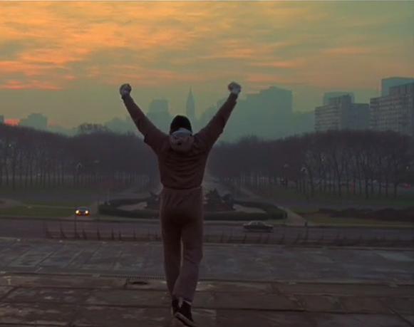
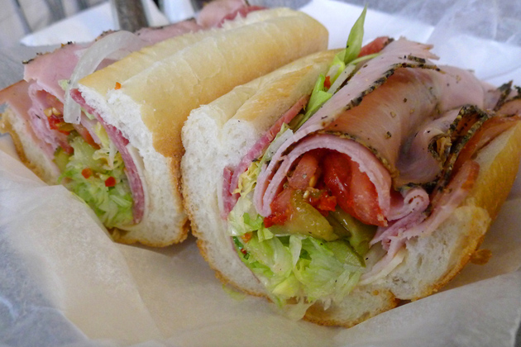
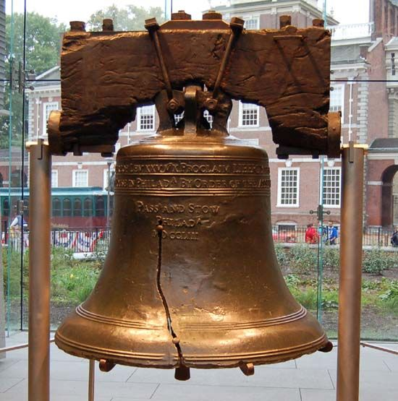
Notes:
PHILADELPHIA
Rocky
Hoagies
Liberty Bell
…this was not the city in Revelation

Slide 46
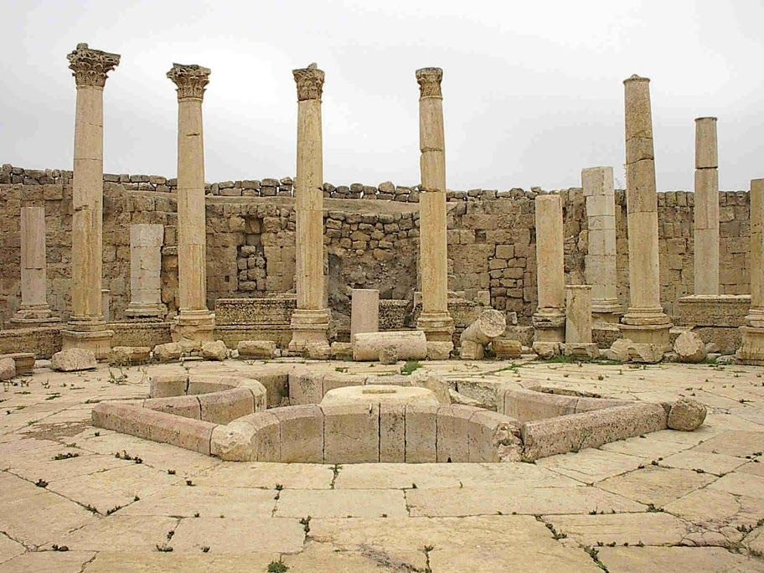
Notes:
ANCIENT PHILADELPHIA
Ancient Philadelphia is located on the Cogamis River in western Asia Minor, about 80 miles east of ancient Smyrna.
Philadelphia was known for its variety of temples and worship centers.
Today, Philadelphia is known as the Turkish city of Alasehir.
Due to a series of ancient earthquakes, there isn’t much left of ancient Philadelphia, and archaeology is limited to foundation stones and a few Roman columns.
Philadelphia: King Eumenes II of Pergamon (197–160 BC) named the city for the love of his brother, who would be his successor.
DISCUSSION: Why do you suppose Smyrna and Philadelphia were included in these chapters when there was nothing bad to say about them?

Slide 47
Laodicea
Rev. 3:14-22
Notes:
LAODICEA
Rev. 3:14-22 (NIV) ⁴ "To the angel of the church in Laodicea write: These are the words of the Amen, the faithful and true witness, the ruler of God's creation. ¹⁵ I know your deeds, that you are neither cold nor hot. I wish you were either one or the other! ¹⁶ So, because you are lukewarm-- neither hot nor cold-- I am about to spit you out of my mouth. ¹⁷ You say, 'I am rich; I have acquired wealth and do not need a thing.' But you do not realize that you are wretched, pitiful, poor, blind and naked. ¹⁸ I counsel you to buy from me gold refined in the fire, so you can become rich; and white clothes to wear, so you can cover your shameful nakedness; and salve to put on your eyes, so you can see. ¹⁹ Those whom I love I rebuke and discipline. So be earnest and repent. ²⁰ Here I am! I stand at the door and knock. If anyone hears my voice and opens the door, I will come in and eat with that person, and they with me. ²¹ To the one who is victorious, I will give the right to sit with me on my throne, just as I was victorious and sat down with my Father on his throne. ²² Whoever has ears, let them hear what the Spirit says to the churches.“
CLASS?
Main characteristic? you are neither cold nor hot (3:15)
Praise? None
Warning? I am about to spit you out of my mouth (3:16)

Slide 48
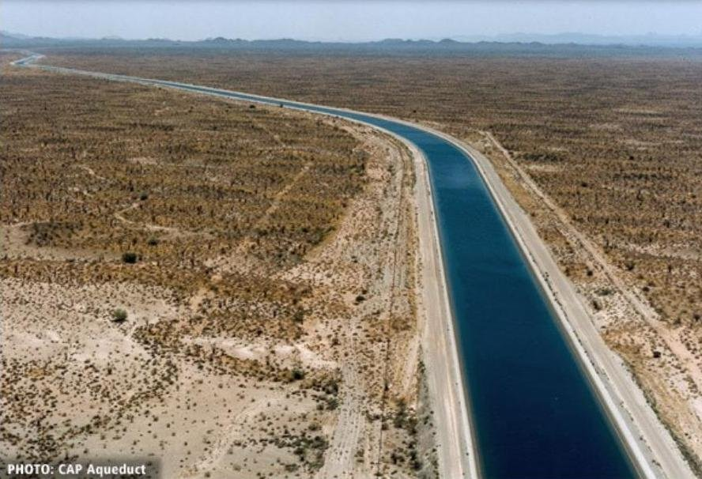
Notes:
Laodicea
Banking and the manufacture of black wool clothing made Laodicea a very rich town.
Laodicea’s water supply was channeled from hot springs some distance away…by the time it reached Laodicea it was tepid.
The church was like its water – lukewarm.
The believers didn’t stand for anything and became very idle…”whatever”
Wealth, luxury, and ease can make people feel confident, satisfied and complacent.
By neglecting to do anything for Christ, the church had become hardened and self-satisfied, it became spiritually indifferent.
DISCUSSION
What conditions can cause a church to become “lukewarm” like the church in Laodicea?
Alexander, David and Pat Alexander. Eerdmans' Handbook to the Bible. Grand Rapids: William B. Eerdmans Publishing, 1973, p. 650.

